Slide 1
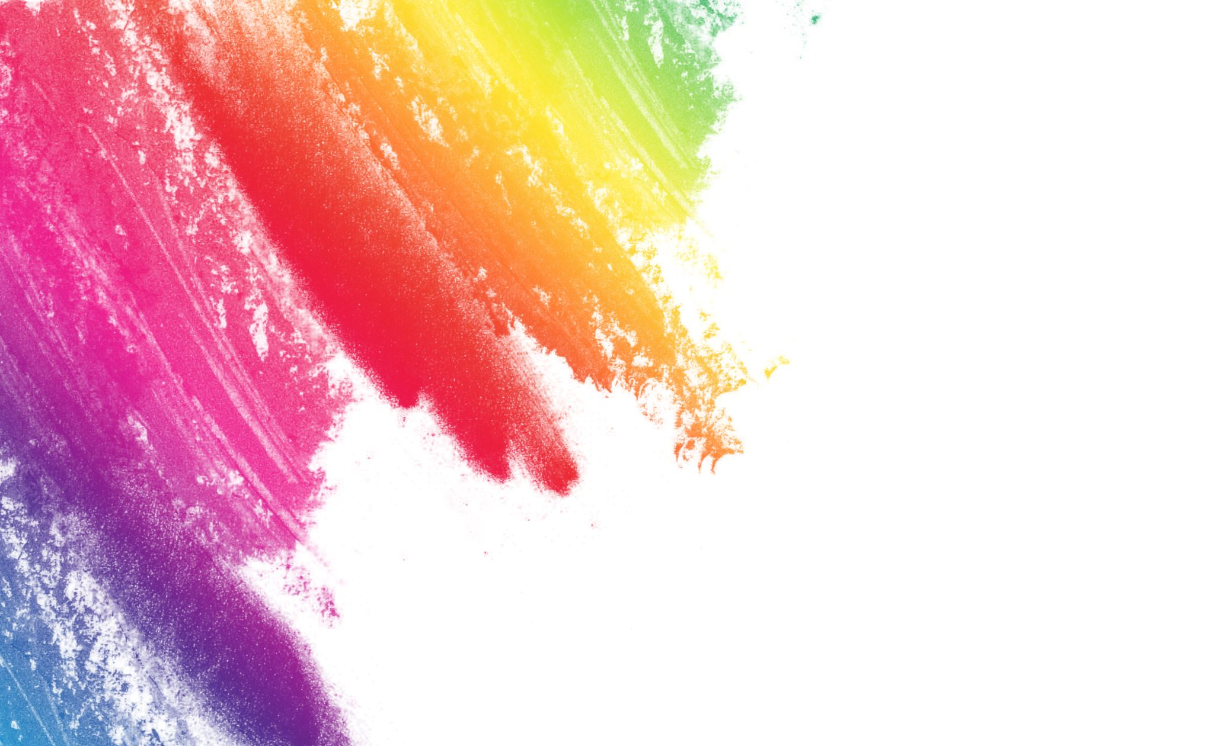
ART4320 Photography II
Color Analysis Project with Python
Hye Young Kim
Winston-Salem State University

Slide 2
Project introduction
Color is one of the most important elements of photography, because it affects everything from composition and visual appeal to the viewer’s attention and emotions.
This project can help you analyze colors of photograph through processing image data using a Python programming language.

Slide 3
Learning Outcomes
Students will understand and apply color theory to their photographs.
Students will analyze colors on digital photographs through image processing using Python.

Slide 4
Project Process
Learn a color theory
Take photos in color harmonies (monochromatic, analogous , and complementary schemes). Choose the best photo for three color harmonies.
Prepare 3 photos in required size in Photoshop (900x600 pixels, 72 dpi).
Use Python. Follow instructions of coding step by step. Create 3 pie charts.
Use Adobe Color. Choose the main color and create 3 color wheels by applying color harmony. https://color.adobe.com/create/color-wheel
Write a color analysis report with 3 photos, 3 pie charts, and 3 color wheels.
Submit the report (ppt/pptx) on CANVAS.
Present your report in a class.

Slide 5
1. Learn Color Theory
Color theory is both the science and art of using color.
It explains how humans perceive color; and the visual effects of how colors mix, match or contrast with each other.
Color theory also involves the messages colors communicate; and the methods used to replicate color.

Slide 6
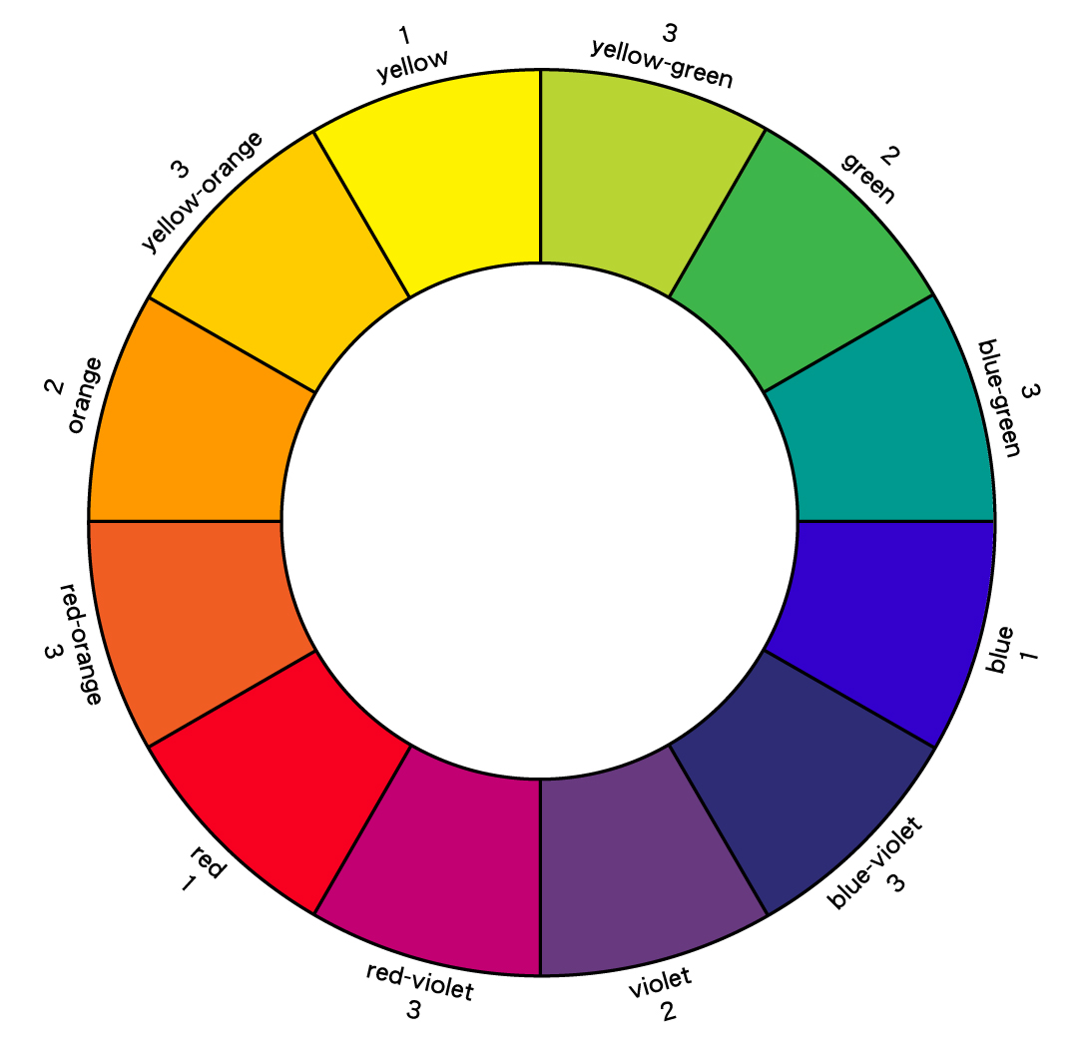
Color Wheel Based on the refracted colors observed by Sir Isaac Newton when light was directed through a prism.
Primary Colors: Yellow, Red, Blue
Secondary Colors: Orange, Green, Violet (colors created when primary colors are mixed)
Tertiary Colors: Mix of a primary and an adjacent secondary. Such as Yellow-green, blue-green, blue-violet, red-violet, red-orange, yellow-orange.

Slide 7
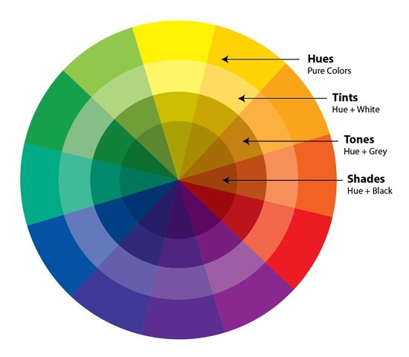
Color Properties
Hue: Name of the color (e.g., yellow)
Value: Relative lightness or darkness
Intensity: (Chroma, Saturation) Relative purity of a color (e.g., high saturation = vivid, low saturation = dull/muted)
Warm colors: located on red-orange side of the color wheel
Cool colors: located on the blue-green side of the color wheel.
Tint: adding white to a pigmented color (e.g., pink is a tint of red). Color lighter than a hue’s normal value
Shade: adding black to a color (e.g., maroon is a shade of red). Color darker than a hue’s normal value.

Slide 8

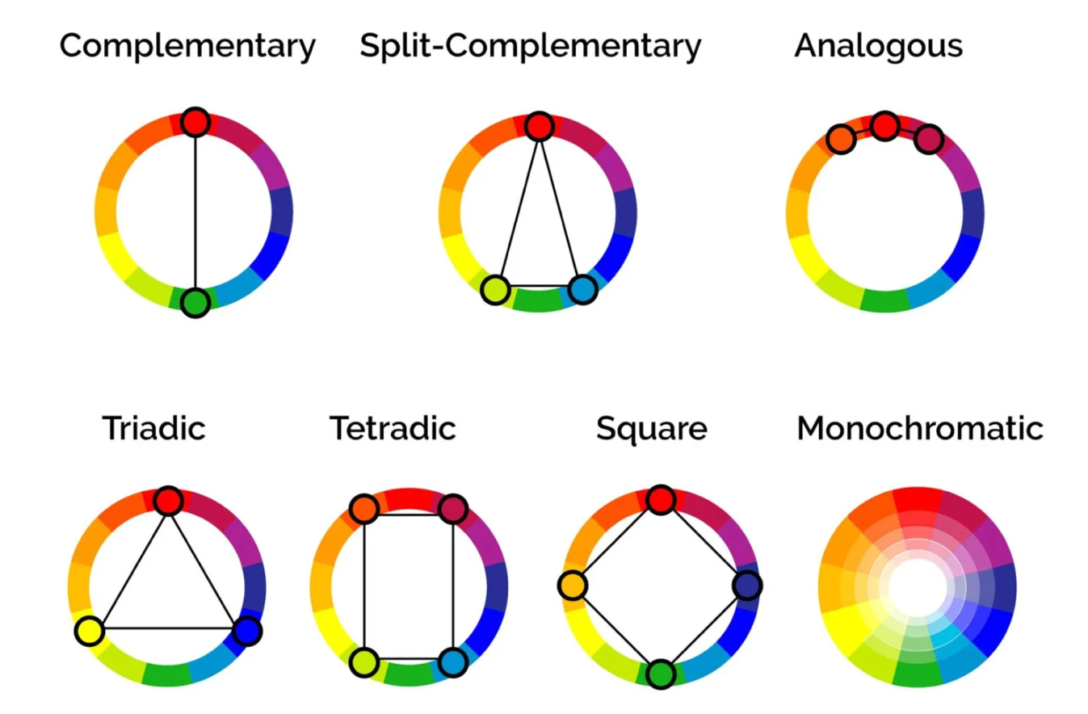
Color Harmonies
A color scheme is the selective use of two or more colors in a single composition.
Monochromatic : Variations of the same hue
Analogous : Adjacent hues on the color wheel
Complementary : Hues directly opposite on the color wheel

Slide 9
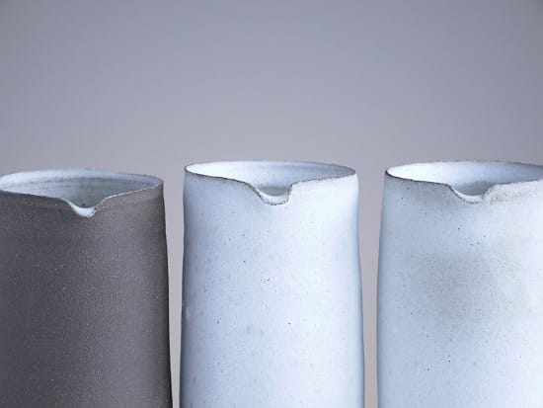
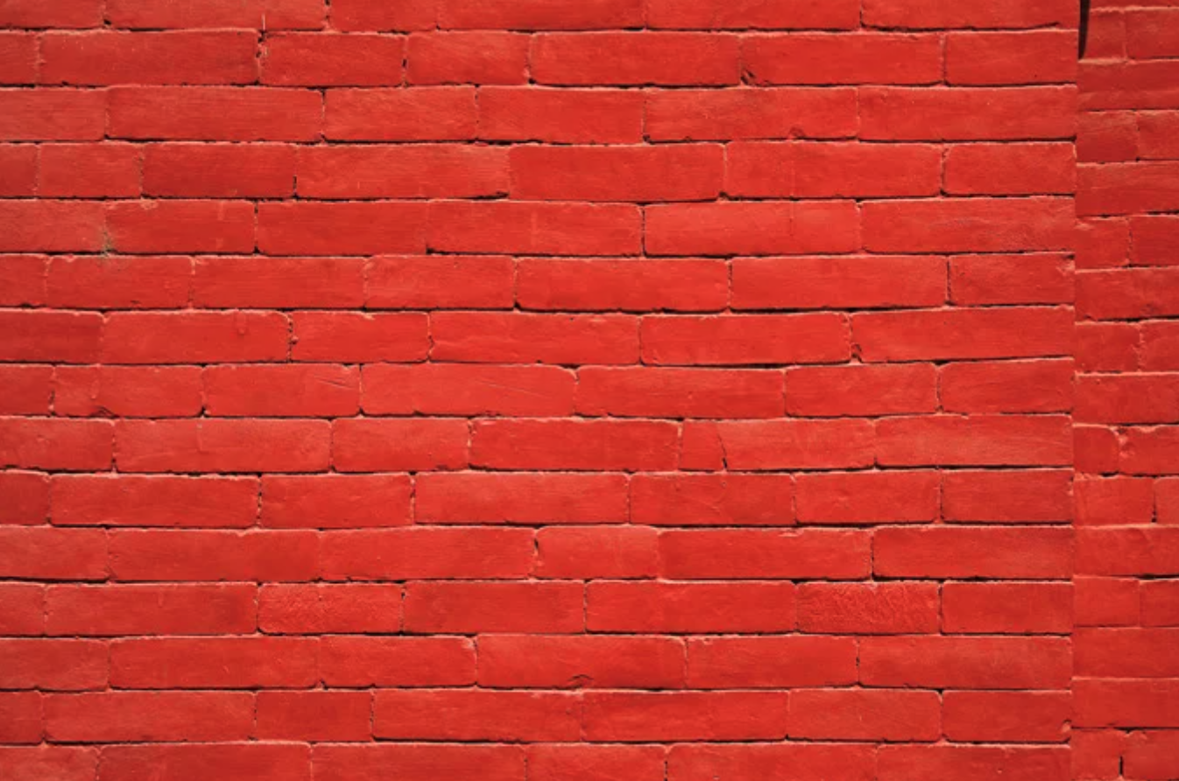
1. Monochromatic colors (BW or 1 color)

Slide 10
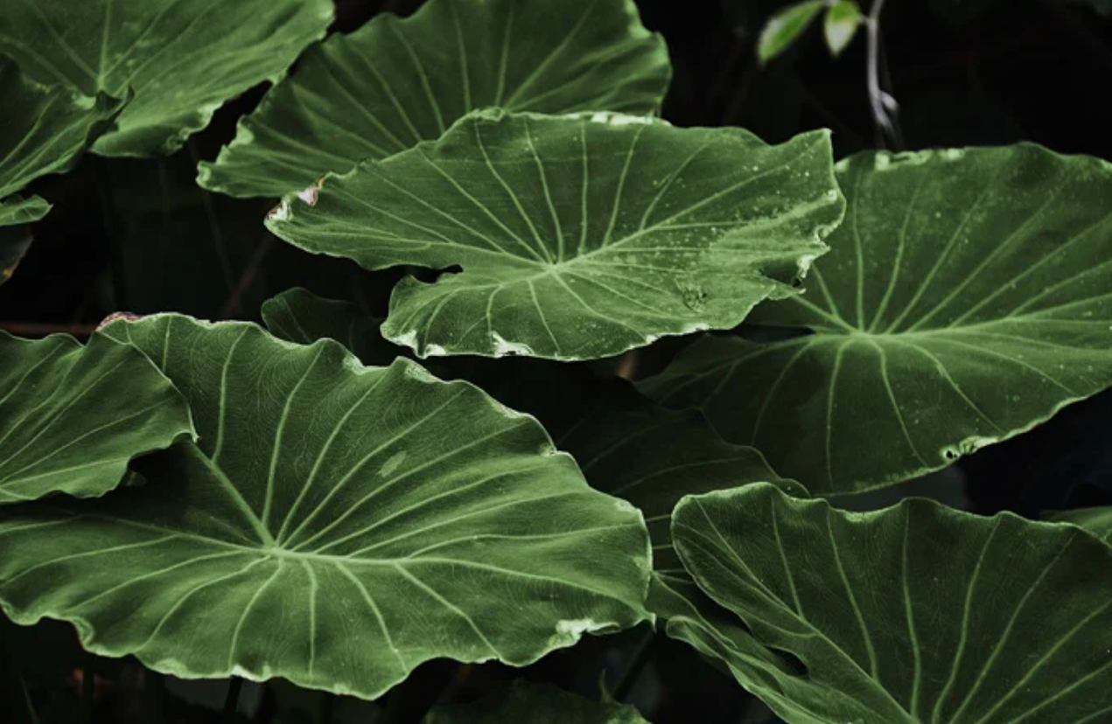
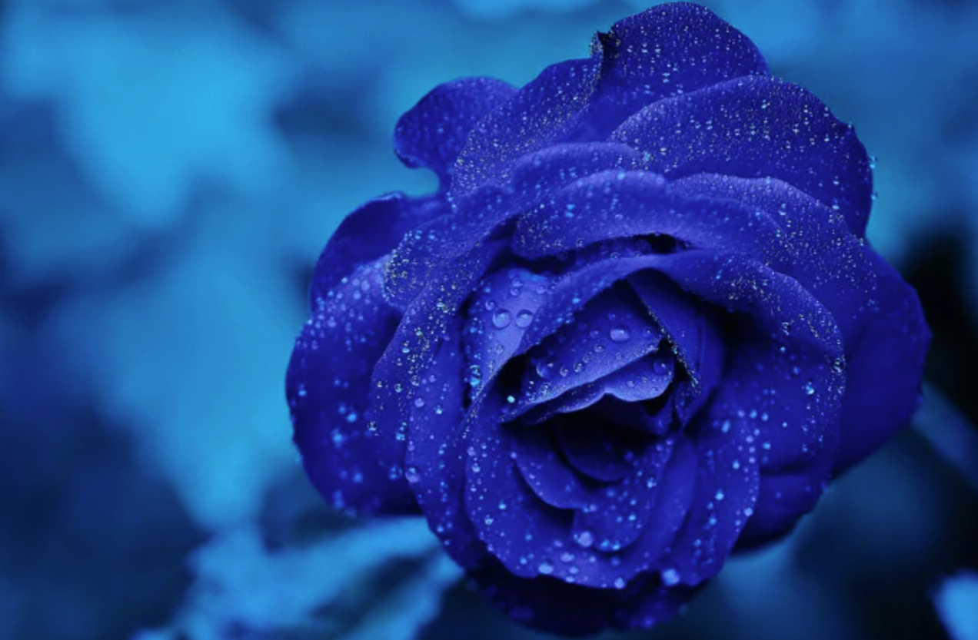
1. Monochromatic colors (BW or 1 color)

Slide 11
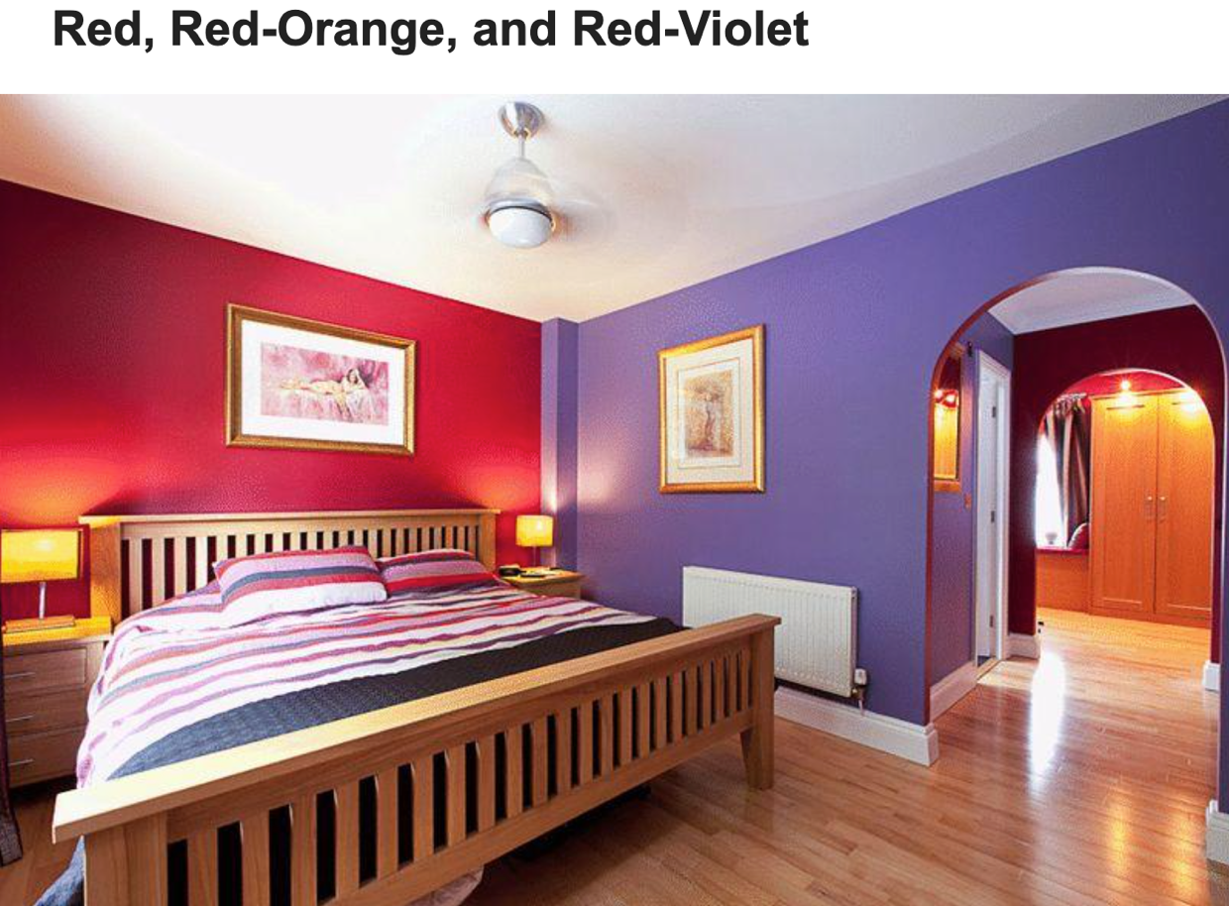
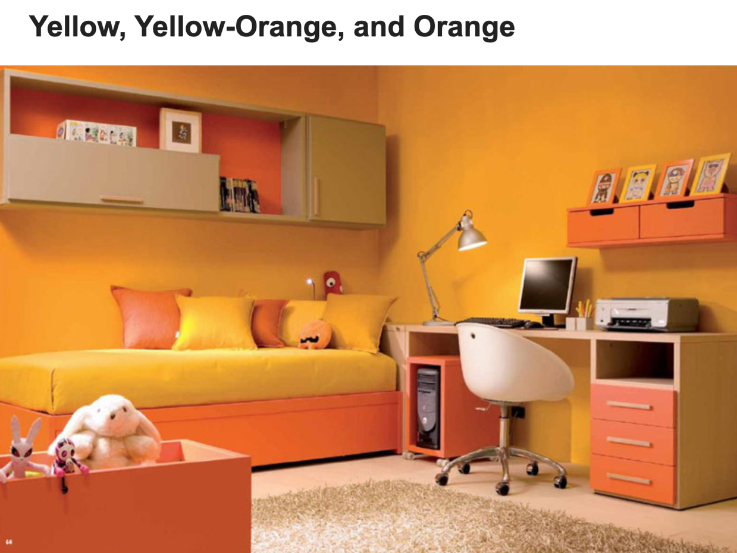
2. Analogous colors

Slide 12
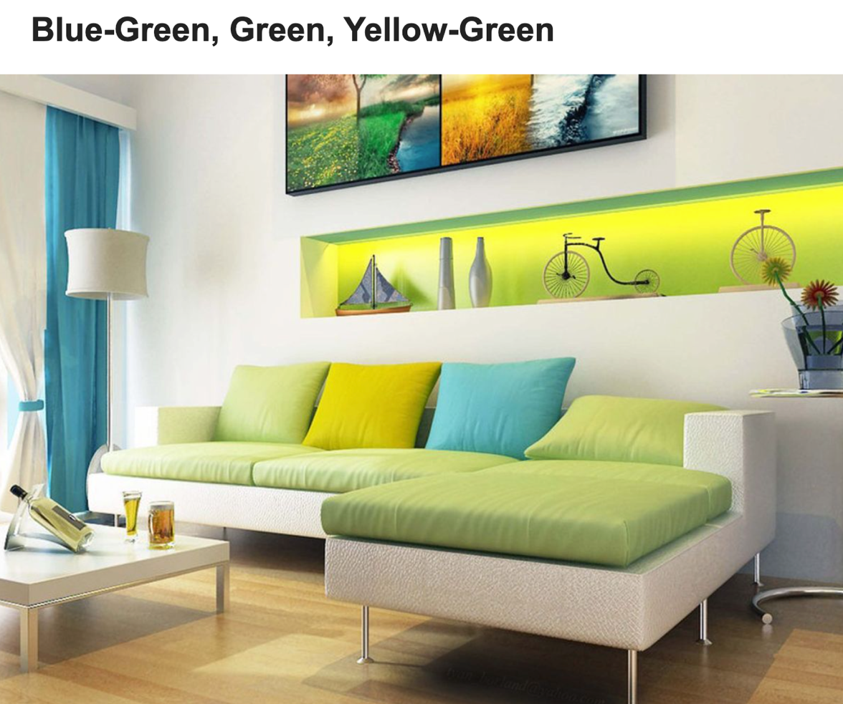
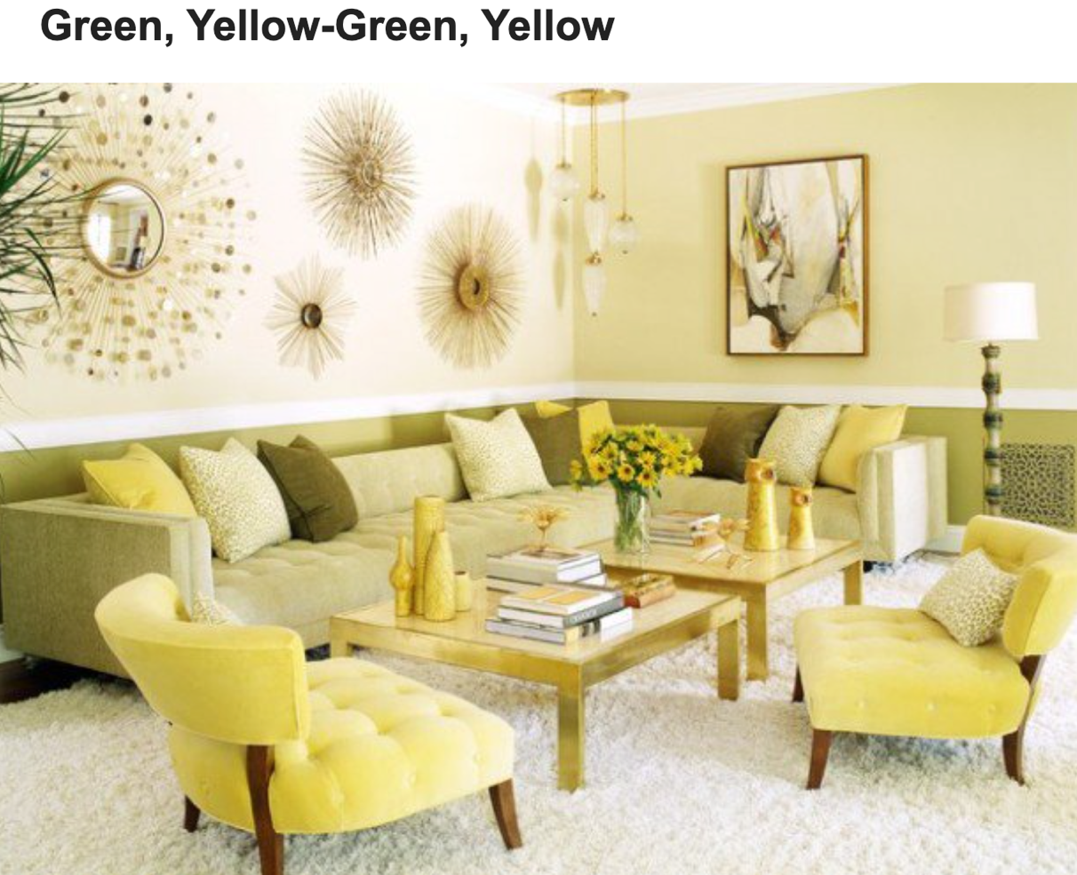
2. Analogous colors

Slide 13
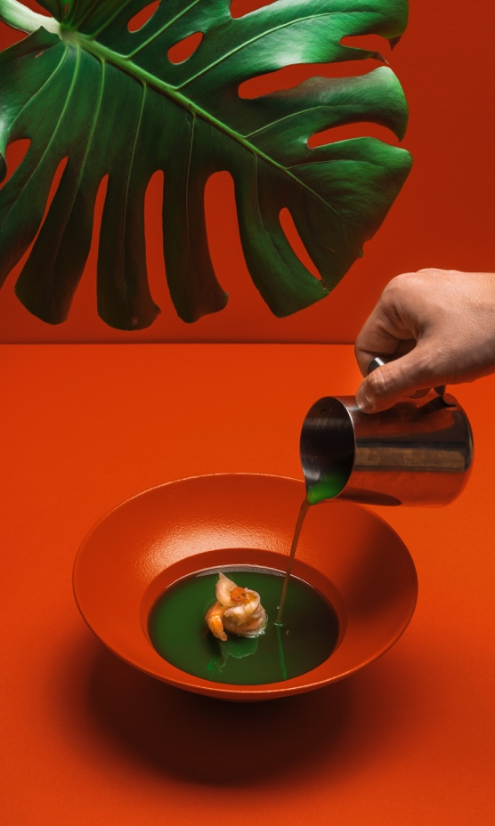
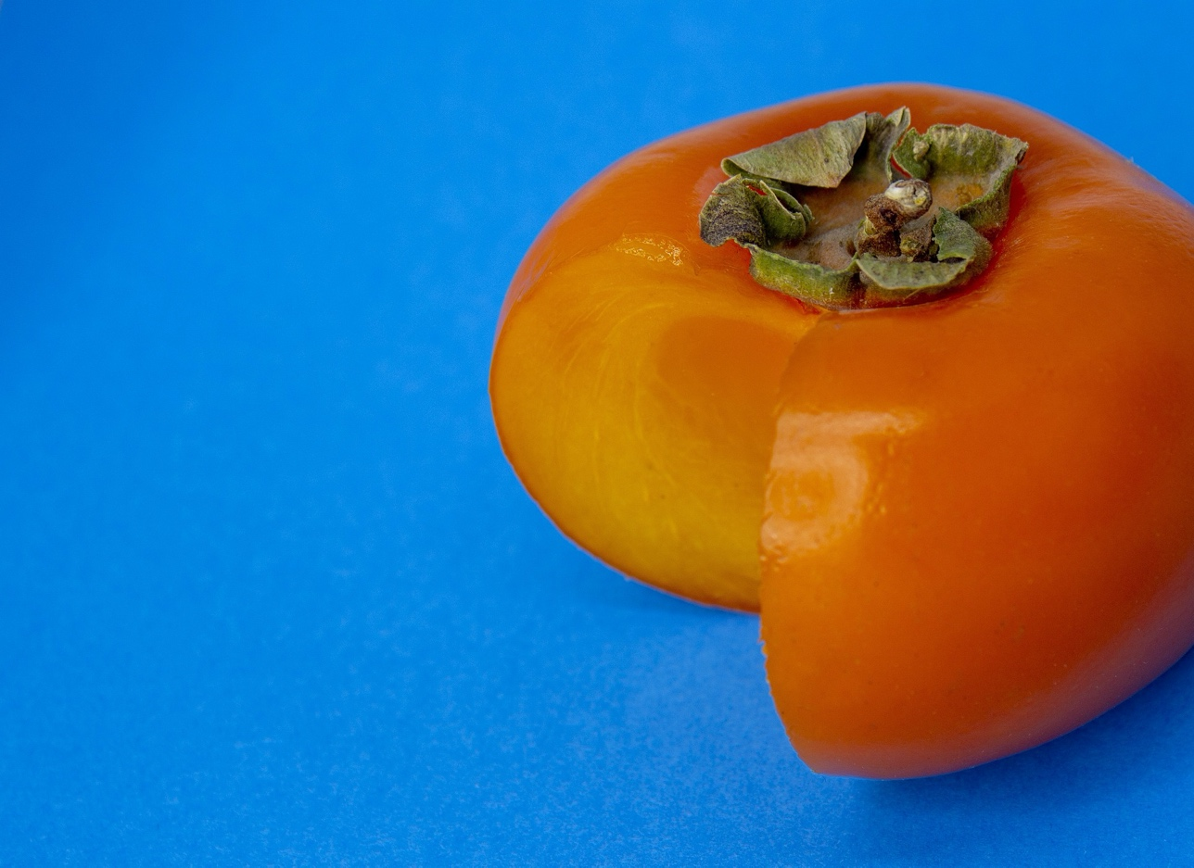
3. Complementary colors :Red/Green, Blue/Orange, Yellow/Purple
Red and Green
Photo by Ruslan Bardash on Unsplash
Orange and Blue
Photo by Irina_kukuts in Pixabay

Slide 14
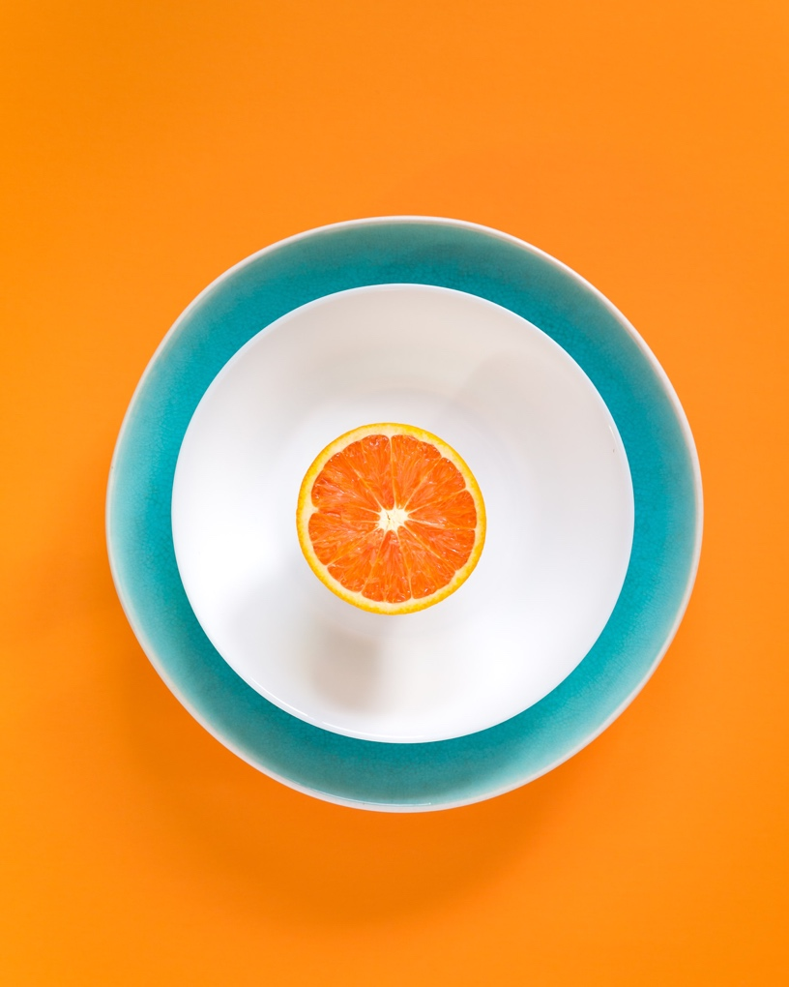
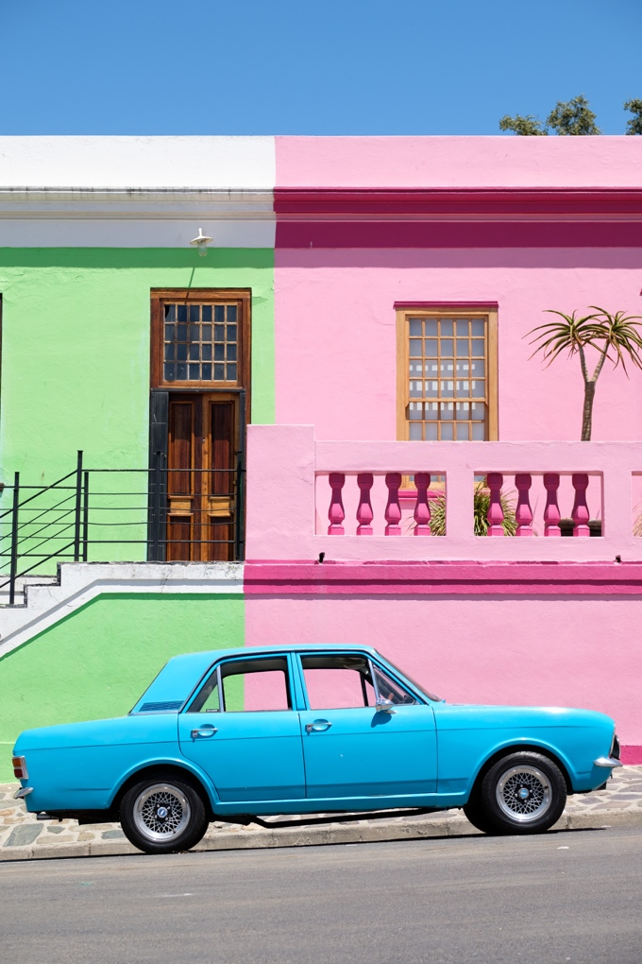
3. Complementary colors :Red/Green, Blue/Orange, Yellow/Purple
Orange and Blue
Photo by Mae Mu on Unsplash
Pink and Light Green
Photo by Arno Smit on Unsplash

Slide 15
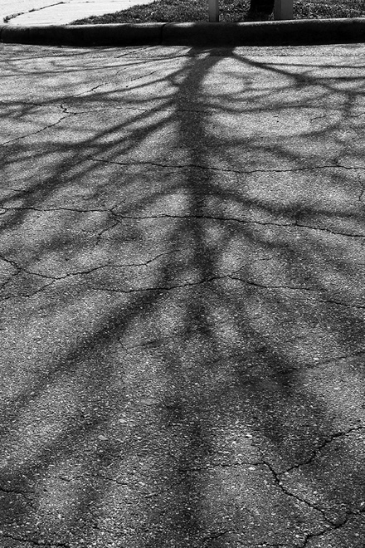
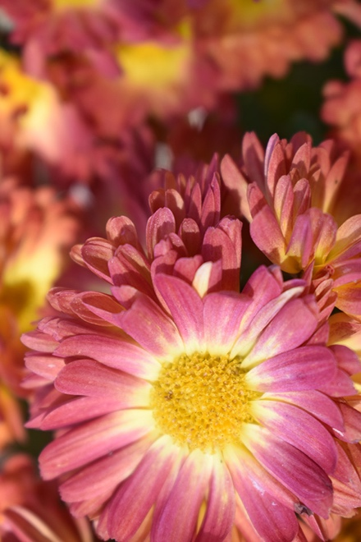
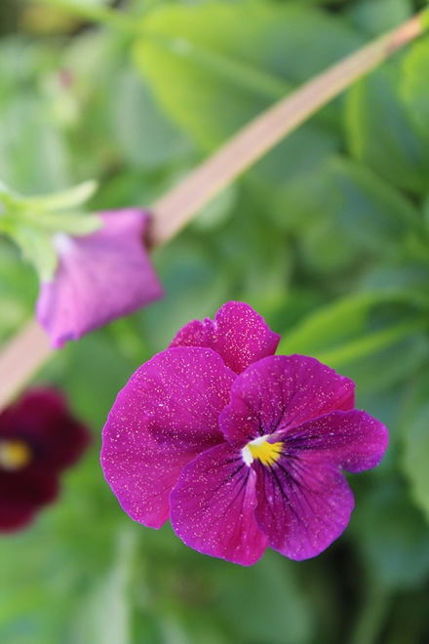
2. Take photos in Color Harmonies. Choose the best 3 photos for each color harmony.
Monochromatic
(Black & White)
Analogous
(yellow-orange-red)
Complementary
(Purple – Green)

Slide 16
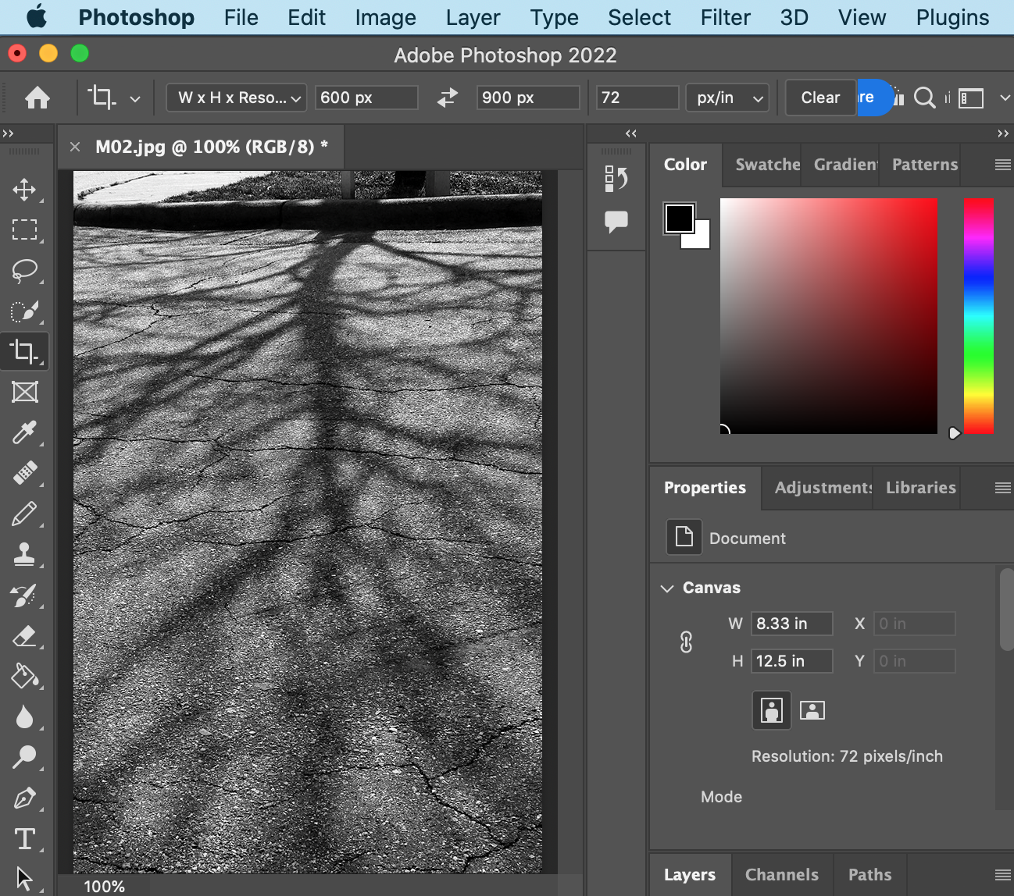
3. Photo editing (600x900px, 72 dpi)

Slide 18
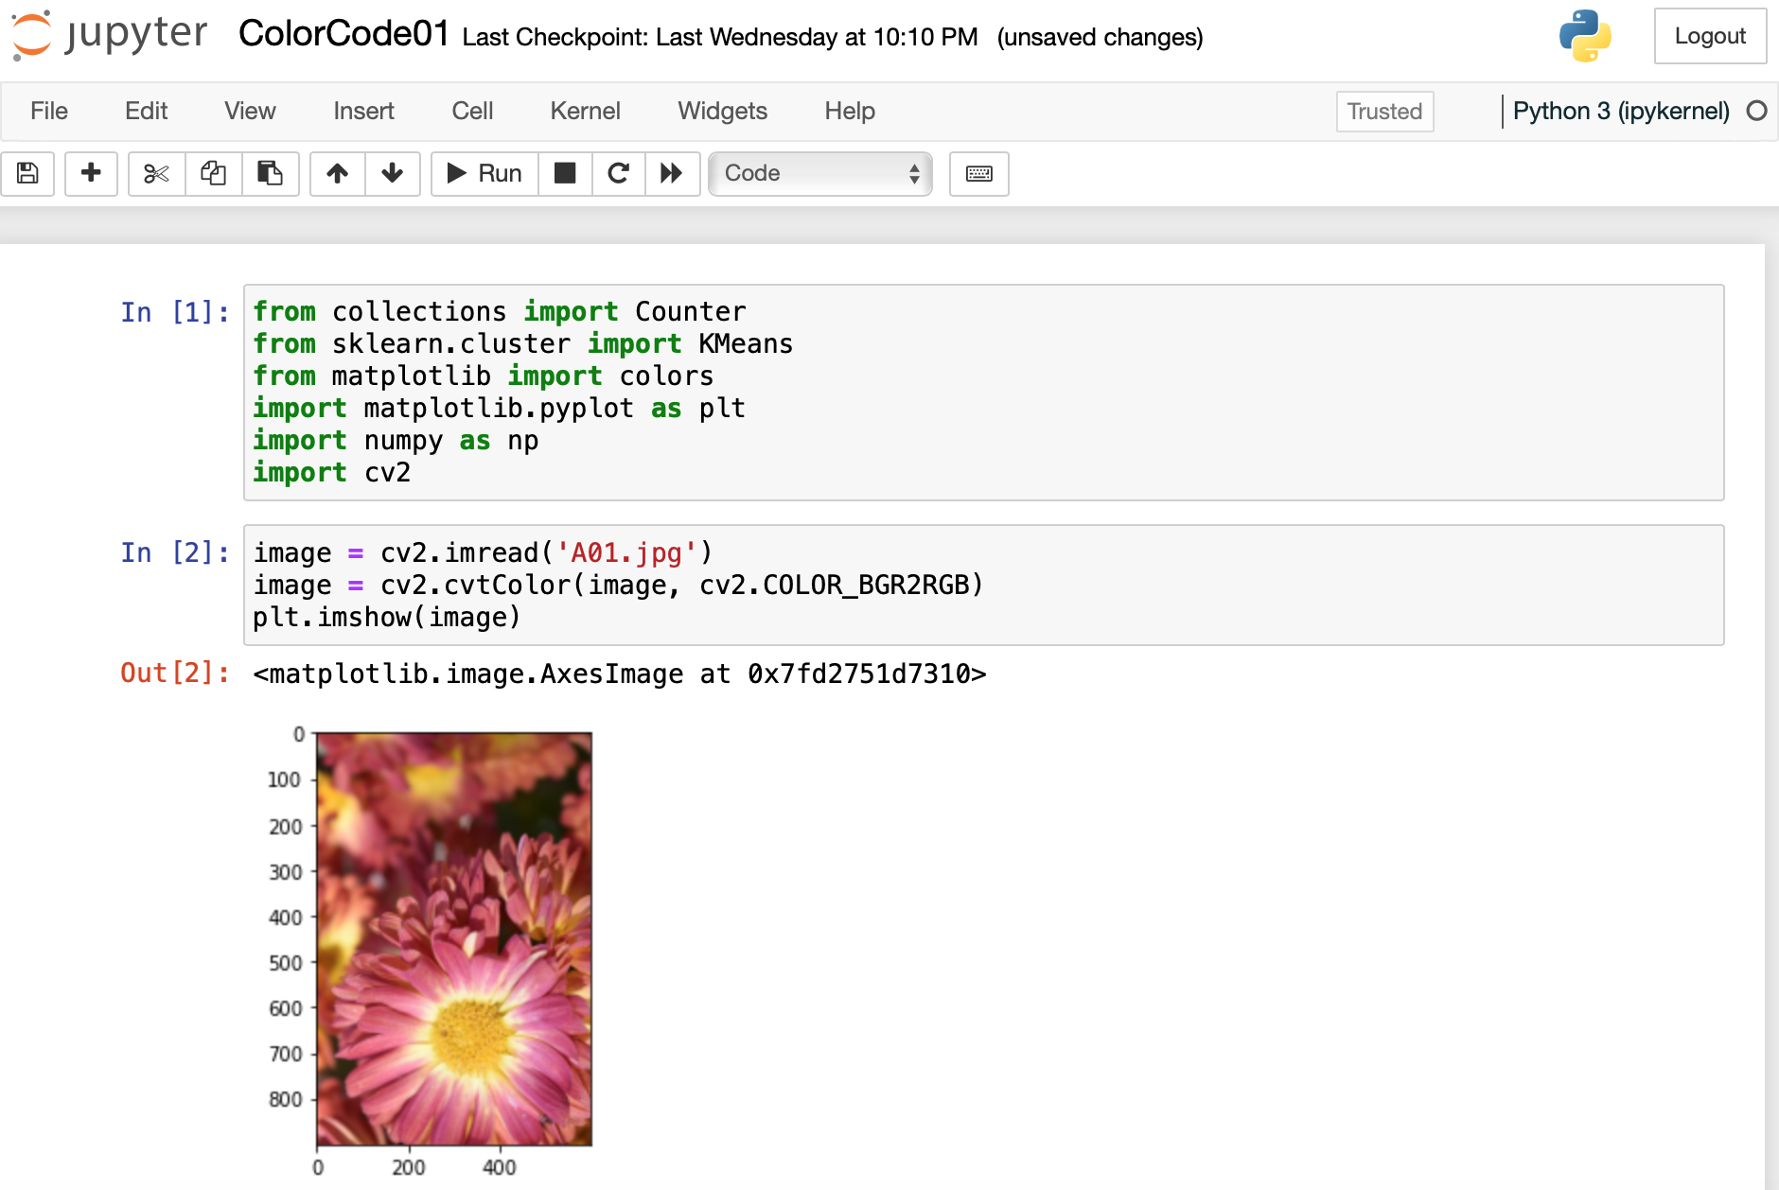
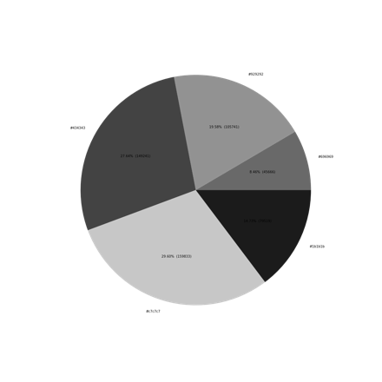
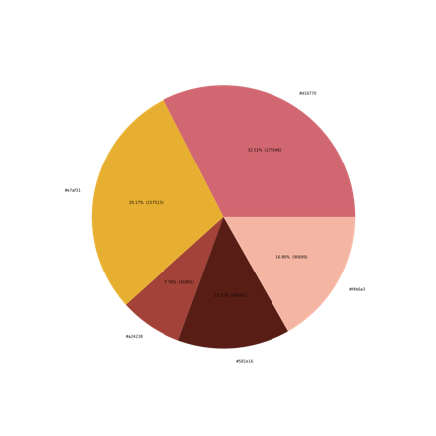
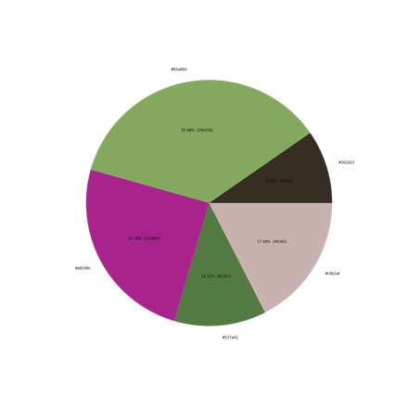
4. Use Python. Follow instructions of coding step by step. Create 3 pie charts.

Slide 19
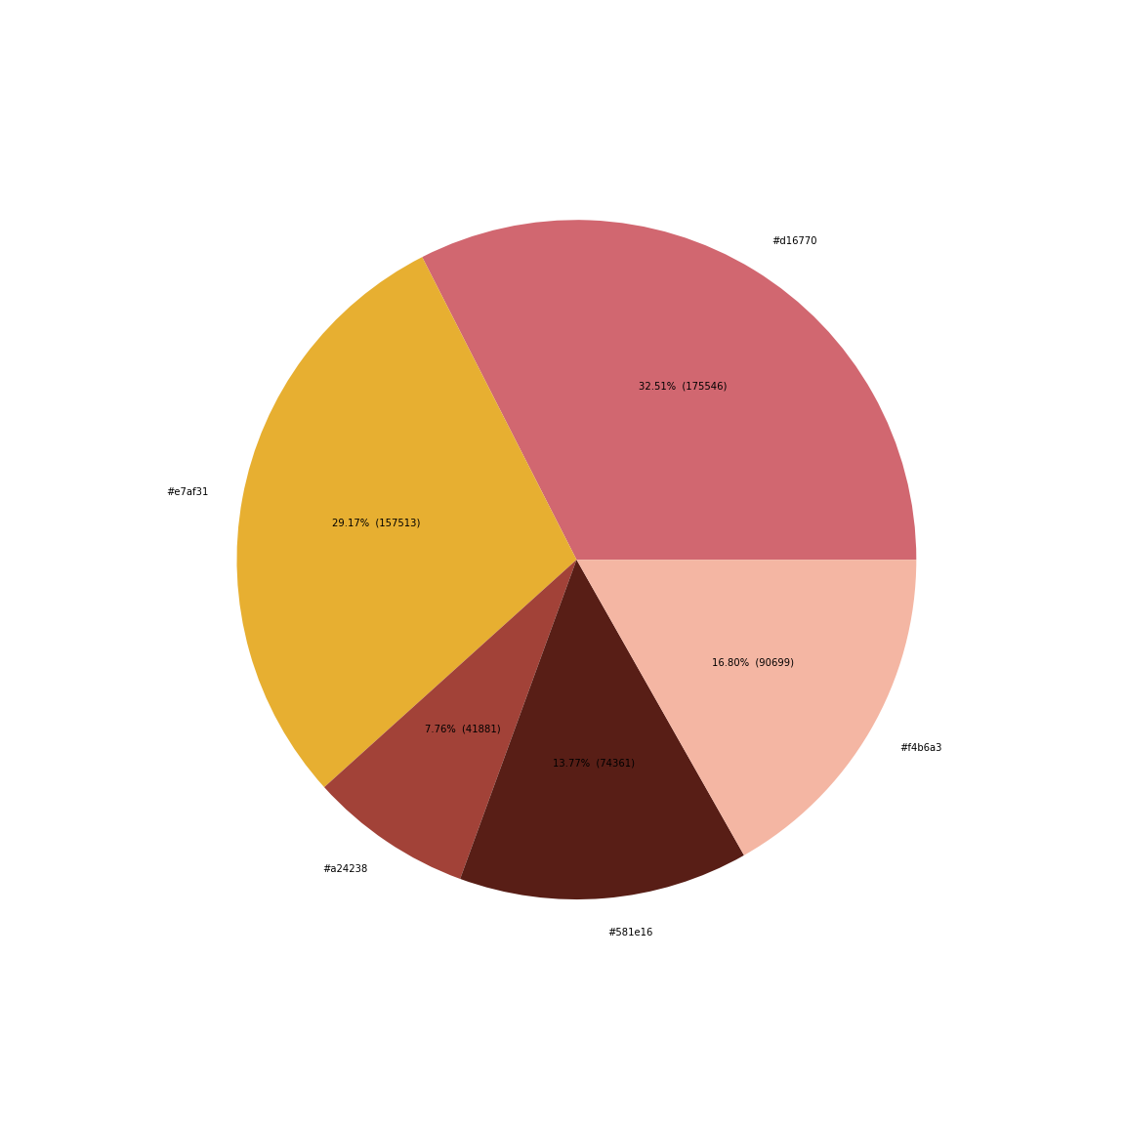
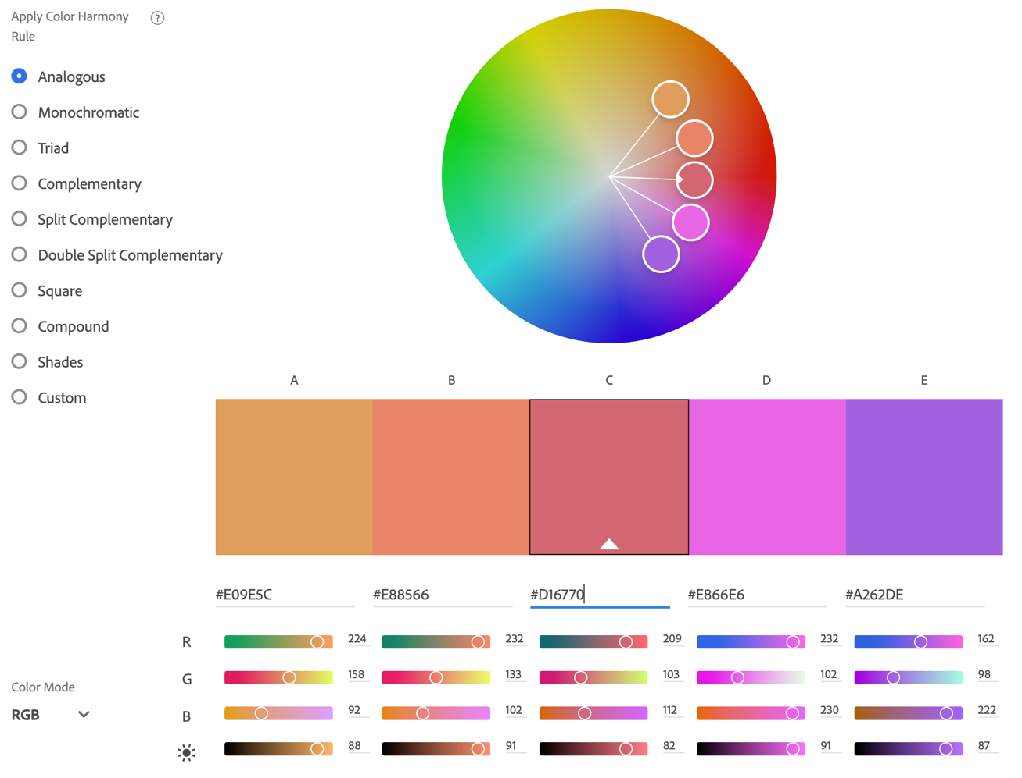
5. Use Adobe Color. Choose the main color from the pie chart. Create 3 color wheels by applying color harmony (e.g., Analogous, #d16770) Screenshots(Mac): Com + Shift + 4 https://color.adobe.com/create/color-wheel
#d16770 (32.51%)

Slide 20
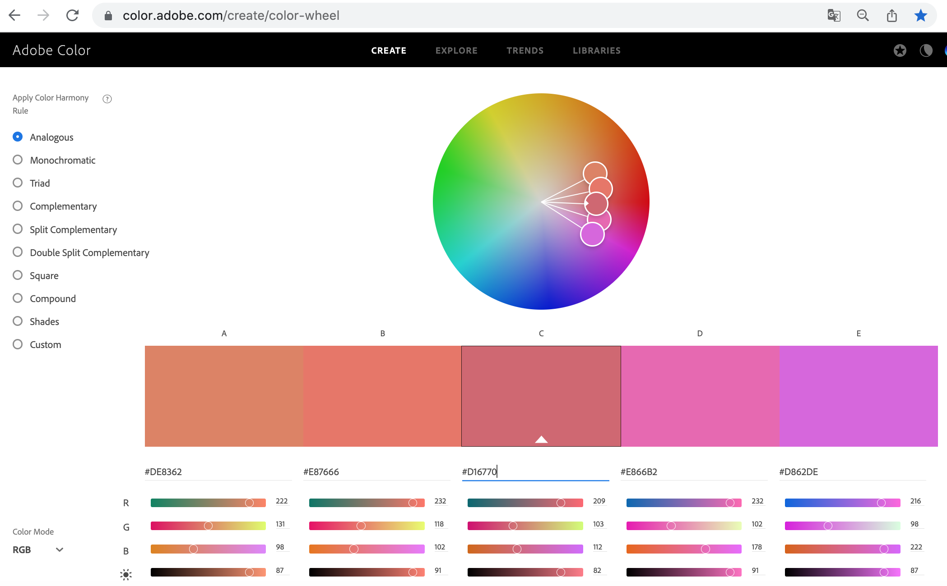

Slide 21
6. Write a color analysis report with 3 photos, 3 pie charts, and 3 color wheels.

Slide 22
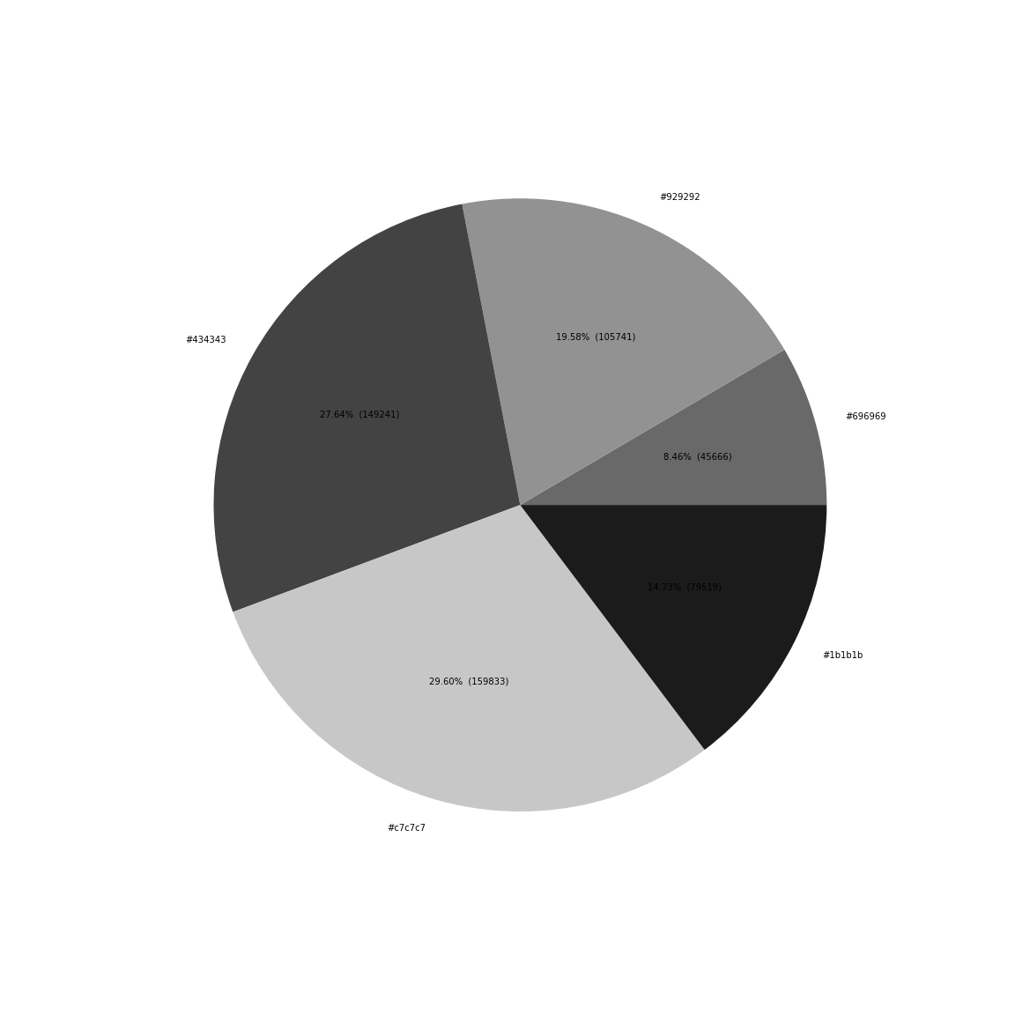
1-1. Monochromatic Example
Explain color harmony with color combination: Monochromatic color scheme with gray tones.
Write 5 hex colors with percentages: #929292(19.58%), #696969(8.46%), #1b1b1b(14.73%), #c7c7c7(29.60%), #434343(27.64%).
Which color is the most used? #c7c7c7 (29.60%)
What is the brightest color? #c7c7c7 (29.60%)
What is the darkest color? #1b1b1b(14.73%)

Slide 23
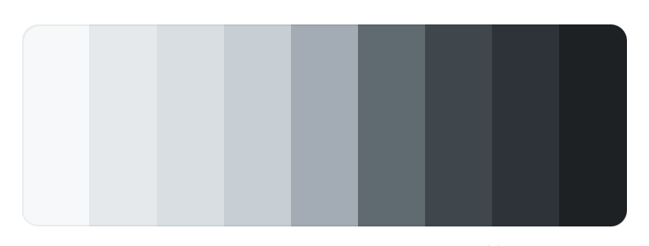
Improvement plan based on color analysis
6. Please write any suggestions to have better color harmony (2-3 sentences).
This photo needs more light tones. It can increase exposure when you take a picture. Or you can edit the photo by increasing brightness.

Slide 24
2-1. Analogous Example
Explain color harmony with color combination: Analogous color scheme with yellow and pink.
Write 5 hex colors with percentages: #d16770(32.51%),#e7af31(29.17%),#f4b6a3(16.80%),#a24238(7.76%), #58le16(13.77%)
Which color is the most used? #d16770
What are analogous colors (color and percentage)? #d16770(32.51%),#e7af31(29.17%), #f4b6a3(16.80%)
What is the colors which are not analogous? #a24238(7.76%), #58le16(13.77%)

Slide 25

Improvement plan based on color analysis
6. Please write any suggestions to have better color harmony (2-3 sentences).
This photo used good balance and harmonies of using analogous colors. You can see #e7af3,# f4b6af, #d16770 are matched with A, B, C on the color wheel. If I want to add more colors, any purple color will be good for harmony.

Slide 26
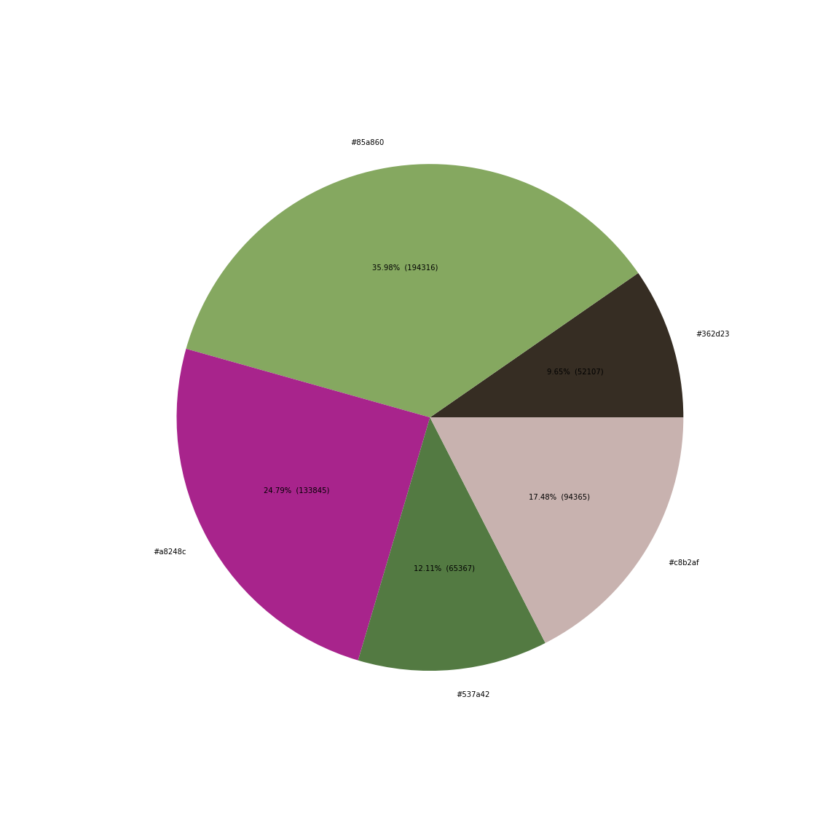
3-1. Complementary Example
Explain color harmony with color combination: complementary color scheme with purple and green.
Write 5 hex colors with percentages: #85a860(35.98%),#a8248c(24.79%),#537a42(12.11%),#c8b2af(17.48%),#362d23(9.65%).
What is the color of the main subject? (color and percentage) #85a860(35.98%)
What are complementary colors (color and percentage)? Purple: #a8248c(24.79%), Green: #537a42(12.11%), #85a860(35.98%)
What is the colors which are not complementary (color and percentage)? #c8b2af(17.48%),#362d23(9.65%)

Slide 27
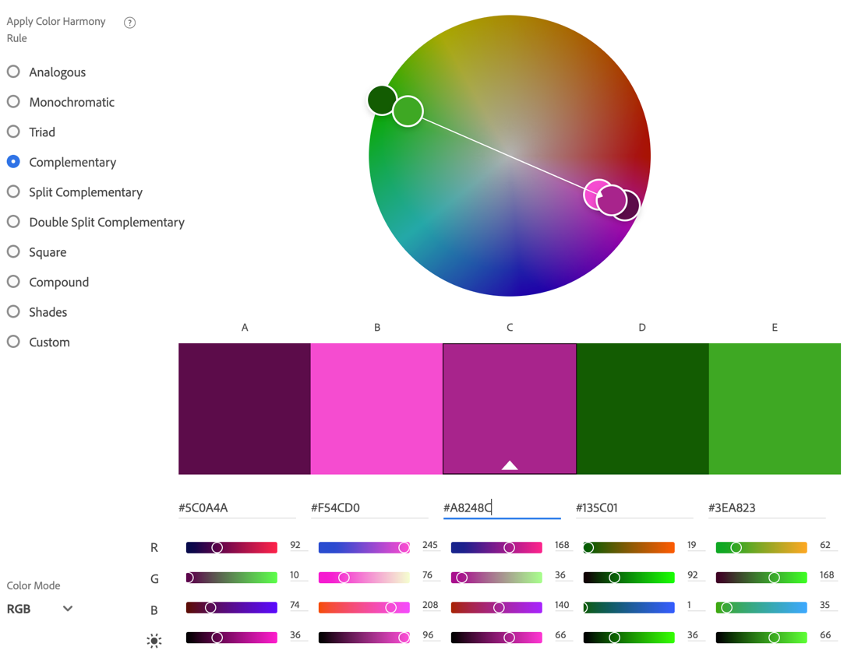
Improvement plan based on color analysis
6. Please write any suggestions to have better color harmony (2-3 sentences).
This photo has a good complimentary color scheme. The purple flower is focused and saturated to get the most attention against green background.

Slide 28
Let’s start.

